Slide 1
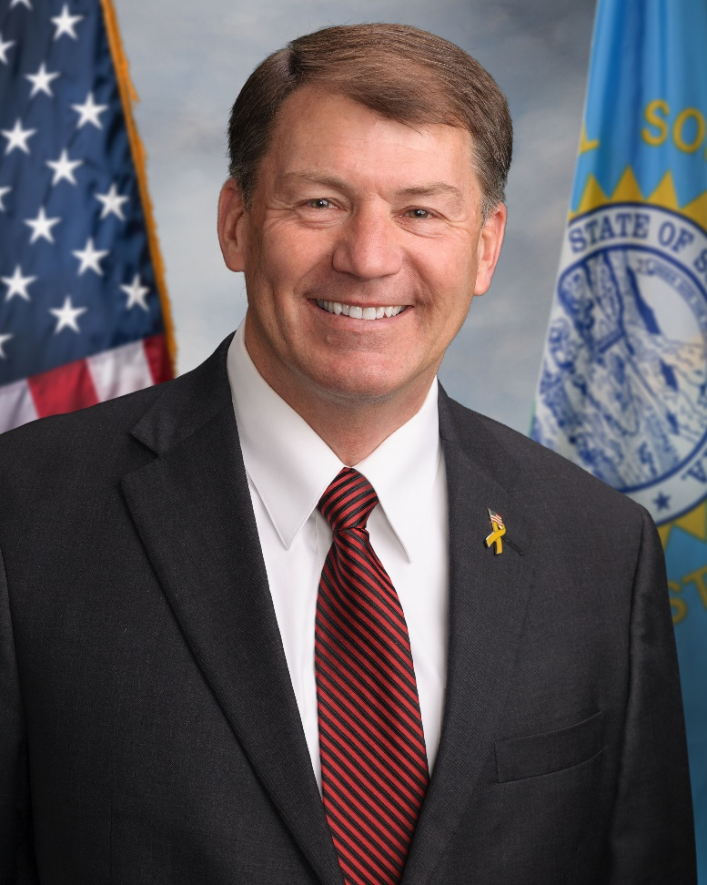
Senator Mike Rounds
Service Academy Day

Slide 2
Office of Senator Mike Rounds
Service Academy Coordinator
603 Omaha Street, Suite 100
Rapid City, SD 57701
Phone: 605-343-5035
Fax: 605-343-5348
Email: academy_nominations@rounds.senate.gov

Slide 3
Nomination vs. Appointment
Nomination: Received from a Congressional or Senatorial office.
Required in order to receive an appointment.
Applying for a nomination is a separate process from applying to the academy.
Appointment: Received from the academy itself.

Slide 4
Appointment Criteria
Appointment and nomination criteria are established by statute and regulations issued by each of the academies.
The U.S. Military, Naval, and Air Force Academies are overseen by the three military branches of the Department of Defense.
The U.S. Merchant Marine Academy is governed by regulations issued by the Department of Transportation.

Slide 5
Congressional Nomination Guidelines
Air Force, Naval, and Military Academies: Each U.S. Senator and Member of Congress may have a maximum of five appointees at each academy at any one time.
Merchant Marine Academy: Each U.S. Senator and Member of Congress may nominate 15 young men and/or women to enter statewide competition for four places at the Merchant Marine Academy.
Coast Guard Academy: There are no Congressional nominations to the Coast Guard Academy. Application should be mailed directly to:
Superintendent
United States Coast Guard Academy
31 Mohegan Avenue
New London, CT 06320

Slide 6
Eligibility
Academy Preference
All academies provide a similar academic experience, therefore it may be beneficial to apply to all academies. This allows the board to potentially nominate you to more than one academy.
Must be a citizen of the United States and a legal resident of South Dakota.
Must be unmarried, at least 17 years of age, nor past your 23rd birthday by July 1st of the year that you would be admitted into the academy.
Multiple Applications
It is recommended to apply for an appointment through other nominating sources: Senator John Thune, Representative Dusty Johnson, and Vice President JD Vance. Please consult their offices for their procedures.

Slide 7
Qualifications
You must generally be in the top half of your class.
For purposes of our nomination, Senator Rounds requires ACT or SAT scores be submitted.
ACT Code is 7182 and SAT Code is 6599
Applicants should have outstanding records of extracurricular activities in schools and communities.
The academies stress the importance of leadership, character,
and motivation.
Each academy has strict standards regarding the physical qualifications.

Slide 8
Application Procedure
Step 1: Contact the academy of your choice directly to open a
pre-candidate file.
Step 2: Complete our application, provide all items from the checklist and mail or email your entire application form in ONE PACKET by October 10 to our Rapid City office.
Postmarked by October 10, emailed by October 10.
An application will be considered complete when all items on the checklist are compiled and sent as one packet (preferably a .pdf file). Your ACT/SAT score may be the only exception.
Please do not send any applications to my Washington, D.C. office. This will result in a delayed application process.

Slide 9
Step 3: Checklist
ACT/SAT SCORE
Please note that your highest ACT/SAT score will be reported to the interview board for consideration.
Your ACT/SAT score may be the only document sent in separate of your complete packet.
Submitting Your Score to My Office
If you have taken the ACT/SAT, provide your score sheet in your packet.
If your high school reports your ACT/SAT score on your official transcript, that will be acceptable to include in your packet.
If you have not taken the ACT/SAT or are planning to take it, send your score directly to us. Use code 7182 for ACT and code 6599 for SAT to submit scores.

Slide 10
Step 3: Continued
Letters of Recommendation
Please include in your compiled packet three letters of recommendation, with at least one written by a teacher or administrator. Letters should be signed by the recommender. If letters appear manipulated or tampered, they can be thrown out from your packet.
Be sure to include all items on checklist (see application).
Step 4: When your entire application is complete, you will receive an email notifying you. There is no need to contact our office in the meantime.

Slide 11
Timeline
Spring: Contact the academies of your choice and open a
pre-candidate file.
You can also begin collecting the necessary data and documents to submit to our office for nominations.
October 10: Senator Rounds completed application packet due. Only completed packets received by October 10 will be accepted.
Mid-October: Letters and email will be sent to you notifying you of your interview time and location.
November: Interviews with Senator Rounds Nomination Advisory Board may be conducted.
No Later Than December 31:You will receive notification of nominations.

Slide 12
Senator Mike Rounds
Service Academy Day
Service Academy Coordinator
603 Omaha Street, Suite 100
Rapid City, SD 57701
Phone: 605-343-5035
Fax: 605-343-5348
Email: academy_nominations@rounds.senate.gov

